Slide 1
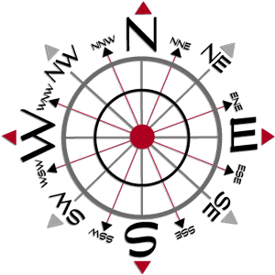
Direction Sense

Slide 2
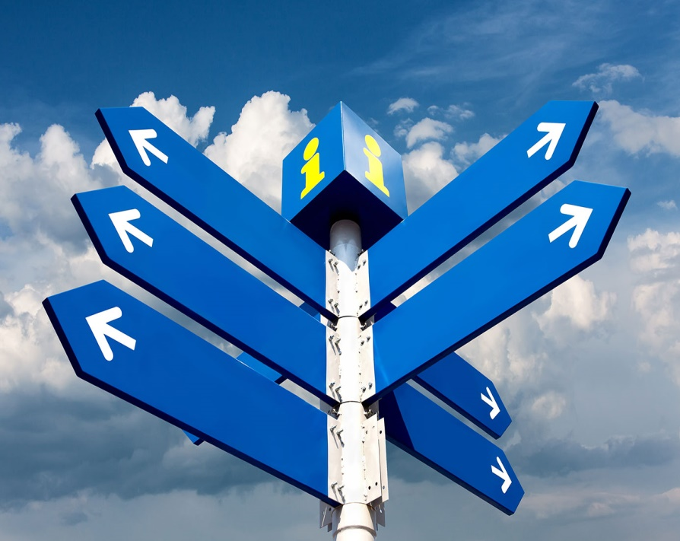
Direction sense is one of the prime topics
in logical reasoning.
Questions from this topic generally involve an individual travelling certain distances in certain directions.
The best way to solve these problems is to represent the traces of the path traversed by the person, as found in the information provided by the question.

Slide 3
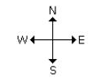

There are four main directions –
North, South, East and West.
There are four cardinal directions – North-East(N-E), North-West(N-W), South-East
(S-E), South-West(S-W).

Slide 4
Things to be noted:
At the time of sunrise if a man stands facing the east, his shadow will be towards west.
At the time of sunset the shadow of an object is always in the east.
If a man stands facing the North, at the time of sunrise his shadow will be towards his left and at the time of sunset it will be towards his right.
At 12.00 noon, the rays of the sun are vertically downward hence there will be no shadow.
Always rainbow will occur opposite to the sun.
Always shortest distance should be calculated.

Slide 5

Examples:
Ashiq walks southwards, then takes a half right turn and then a left turn. In which direction is he walking now?
South-East
South-West
South
North
Ans: a)South-East

Slide 6
A man walks northwards. After a while he turns to his right and a little further to his left. Finally, after walking a distance of 1km, he turns towards his left again. In which direction is he moving now?
South
North
West
East
Ans:c) West
Man is facing towards West direction.

Slide 7
A man started walking positioning his back towards the sun. After sometime, he turned left, then turned right and then towards the left again. In which direction is he going now?
North or South
East or west
North or West
South or West
Ans:
There is no clue to find whether the sun is in East side or West side

Slide 8
A man went 10 kms towards south. Then turned East and covered 10 kms and turned to the right. Again after 10 kms he turned to the left and covered 10kms to reach the destination. How far and in which direction is he to his starting point?
20√2 km, South- East
20√2 km, North- East
20√2 m, South- East
20 km, South East
Ans: a)

Slide 9
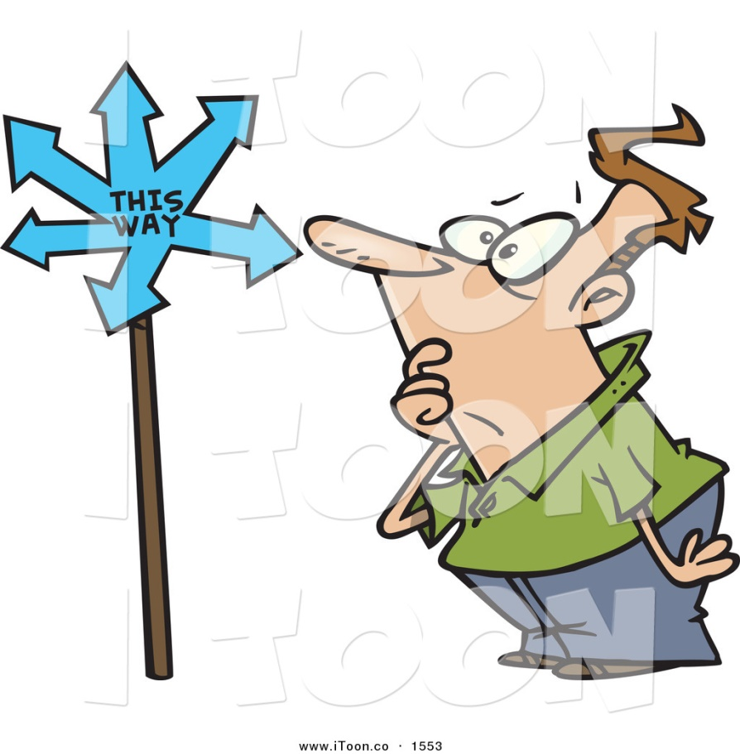
A man went 15 kms to the North. Then he turned West and covered 10 kms. Then he turned south and covered 5 kms. Finally, turned to East, he covered 10 kms. In which direction is he from his house?
West
East
North
South
Ans:

Slide 10
Roshan walks 10 metres westwards, then turns left and walks 10 metres. He then again turns left and walks 10 metres. He takes a 45 degree turn to his right and walks straight. In which direction is he walking now?
South-East
South
South-West
East
Ans:

Slide 11

After his office hours in the evening, Gautam starts walking facing the sun. First he turns to his right, then he turns to his left and after walking for some metres to his left, he turns to his right. In what direction is he moving now?
South
North
East
West
Ans:

Slide 12
Amit’s office is situated 5 kilometres North of Ben’s office. Ben starts from his office and walks 2 kilometres towards Amit’s office. He then turns right and walks 3 kilometres and then turns left and walks 3 kilometres. To which direction will he turn to reach Amit’s office?
West
North
South
East
Ans:

Slide 13
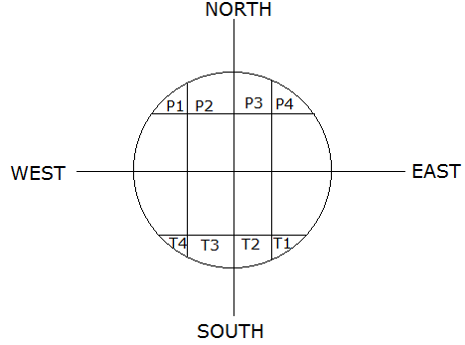
Directions for Q9 to Q12:
Four Policemen P1, P2, P3 and P4 are combing a circular park which is divided into 16 plots. The thieves T1, T2, T3 and T4 who are in the park are to be arrested. The figure below shows their position.

Slide 14
From the given alternatives, identify the pair where one is positioned in the North-West and the other in the South-East?
a) P2,T3 b) T1,P1 c) T4,P4 d) T2,P3
Ans:
If P1,P2,P3,P4 move four plots in a clockwise direction and T1,T2,T3,T4 move six plots in an anti-clockwise direction, who would be in the North-South direction?
P2,T2
T3,P4
T4,P1
T1,P3
Ans:

Slide 15
If the four policemen move two plots clockwise and T1,T2,T3,T4 move two plots vertically up, who will be able to catch whom?
P3,T1
P4,T2
P1,T3
P2,T4
Ans:
If the policemen move four plots anti-clockwise and the criminals move two plots vertically up, who would be facing North-Southwards?
P2,T1
P1,T3
P1,T4
P4,T4
Ans:

Slide 16

A lady leaves her home and walks 30 metres in North-West direction and then 30 metres in South-West. Next, she walks 30 metres in South-East direction. Finally, she turns towards her house. In which direction is she moving now?
North-East
South-East
North-West
South-West
Ans:

Slide 17
Deepak walks 8 kilometres East, turns South-West and walks another 8 kilometres. He again takes a turn towards North-West and walks another 8 kilometres. In which direction from his starting point is he standing now?
North-East
South
West
East
Ans:

Slide 18
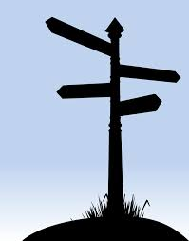
The school is to the West of the hospital. The hospital is to the South of the police post. The workshop is to the North of the school. If the 4 places are equidistant from each other, then to which direction of workshop is the police post?
East
West
North
South
Ans:

Slide 19
Directions for Q16 to Q20:
Joe walks 2 kilometres towards North and turns to his right and walks 4 kilometres more. He then turns to his right and walks 4 kilometres and turns again to his right and walks another 4 kilometres. Here he meets Renu who is coming from the opposite direction. They both stop there.
After taking the first turn, in which direction was Joe going?
South
North
West
East
Ans:

Slide 20
If the starting point is marked ‘A’ and finishing point is marked ‘B’. What will be the distance between these points?
10Km
8km
6km
2km
Ans:
From which direction was Renu coming?
West
North
East
South-East
Ans:

Slide 21
After taking the second turn, in which direction was Joe walking?
South
West
North
East
Ans:
If Joe is to again reach the point from where he started, in which direction will he have to go from where he’s standing now?
East
North
South-East
North-East
Ans:

Slide 22
A clock is so placed that at 12 noon its minute hand points towards North-East. In which direction does its hour hand point at 1.30 pm?
North
South
East
West
Ans:
One evening before sunset, two friends Jane and Jackie were talking facing each other. If Jackie's shadow was exactly to his right side, which direction was Jane facing?
North
South
East
West
Ans:

Slide 23

From her house, Mamta walked 6 kilometres to the North-East to reach a shop. From there she took a right turn, walked another 6 kilometres to reach her friend’s house. How far is her friend’s house from her house (along the eastern direction)?
√72
12
√50
6
Ans:

Slide 24
One Morning after sunrise, Sumesh and Ratheesh were standing on a lawn with their back towards each other. Sumesh’s shadow fell exactly towards his left hand side. Which direction was Ratheesh facing?
East
West
South
North
Ans:

Slide 25

Q is to the South-West of P; R is to the East of Q and South-East of P; and S is to the North of R in line with QP. In which direction of P, is S located?
East
North
South-East
North-East
Ans:

Slide 26


